Slide 1

Project 1-
Naives Bayes Classification
Brannon Dugick

Slide 2

Overview
Use Case
About the Data
The Approach
What we did
Results
Hmmmmm
Lessons Learned & Modifications

Slide 3
Use Case- Binary Classification on transaction data
Did the customer find what they wanted?
Does this customer have good credit?
Will they purchase this product(s)?
Did the customer qualify for financing?

Slide 4
The Data
Anonymized
Type
Shape
Discrete
&
Continuous
180K Records
53 Features
Target
Boolean
Feature
Float
Shape
NEPTUNE
SATURN
It’s a gas giant and has rings
Neptune is the farthest planet

Slide 5

The Approach
01
Data Collection
Land data from S3 storage
02
Data profiling & wrangling
Understand the entire data set
Harmonize data for analysis.
03
Data Analysis
Plot
Correlate
04
Process
Train/Test
Validate
05
Results
Performance
Accuracy
Notes:
Process- Split into a Training subset (first you train your model, look out the outputs) then you test your model. Finally you validate your model with metrics.

Slide 6
What we did -
Minor Data Wrangling
Fit, Predict, Train
Test/Train
Gaussian Naives Bayes
Performance
Pair Plots
Confusion Matrix
Cross Validate
Correlate
Absolute Value
Loop
Notes:
Why Gaussin- Simplicity with smaller record sets, assumes normal distribution, relatively stable to parameter tuning and less prone to overfitting
Data wrangling- removing ID Code and Unnamed, No Nulls
Pair Plot- to check for normal distribution of feature
Correlate our feature against our Target- Leverage a Heatmap.
Abs- This method computes the absolute values of the correlation coefficients. It ensures that both positive and negative correlations are treated equally in terms of their magnitude
Fit- Predict- Train - Segment dataset into training and testing datasets, training a Gaussian Naive Bayes (GNB) model.
Performance/Confusion=
Produced a confusion matrix which indicates whether the model predictions closely match the actual values.
Cross Validate-
Using acurrace as a score I used cross validation to validate the model.

Slide 7
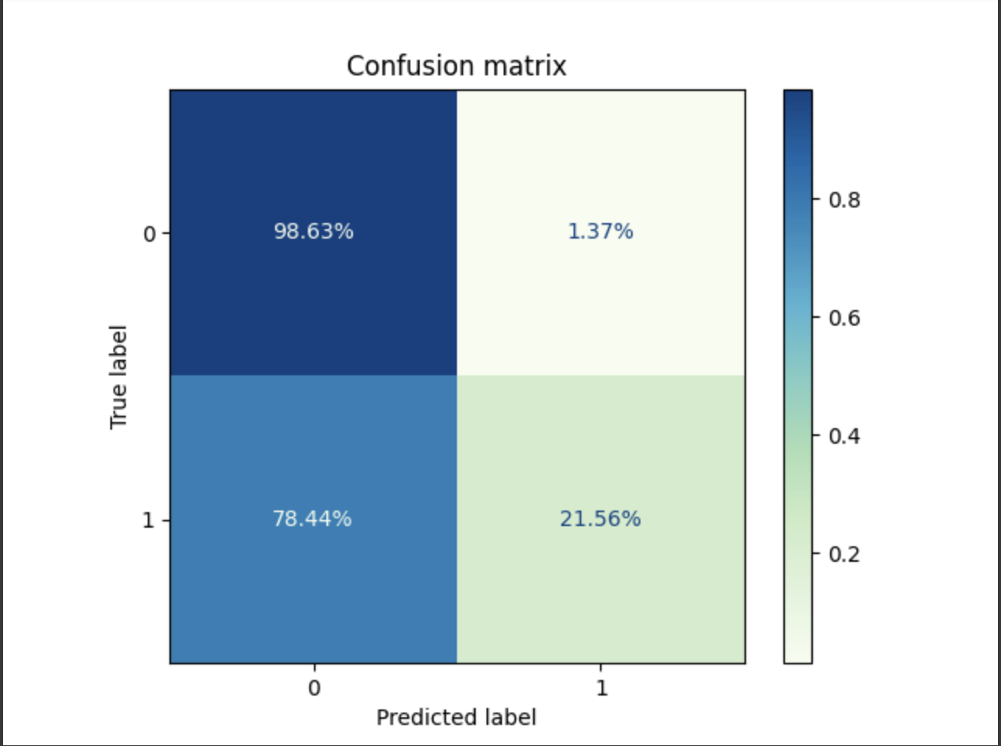
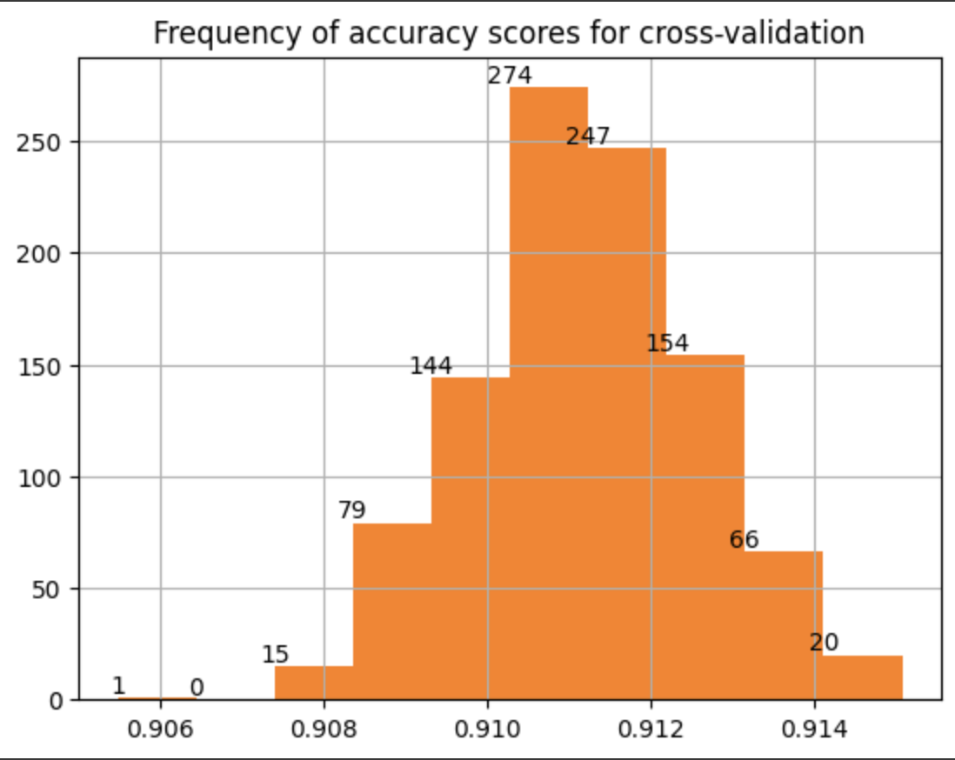
Results
91%
Accuracy Score
Notes:
The accuracy score is 91 percent. Bases on cross validation.
But leveraging a Confusion Matrix i also see that 78 percent of 1 are being predict as 0. This shows that while the accuracy score is correct. Simply going off that metric as a barometer of success is a fallacy.

Slide 8
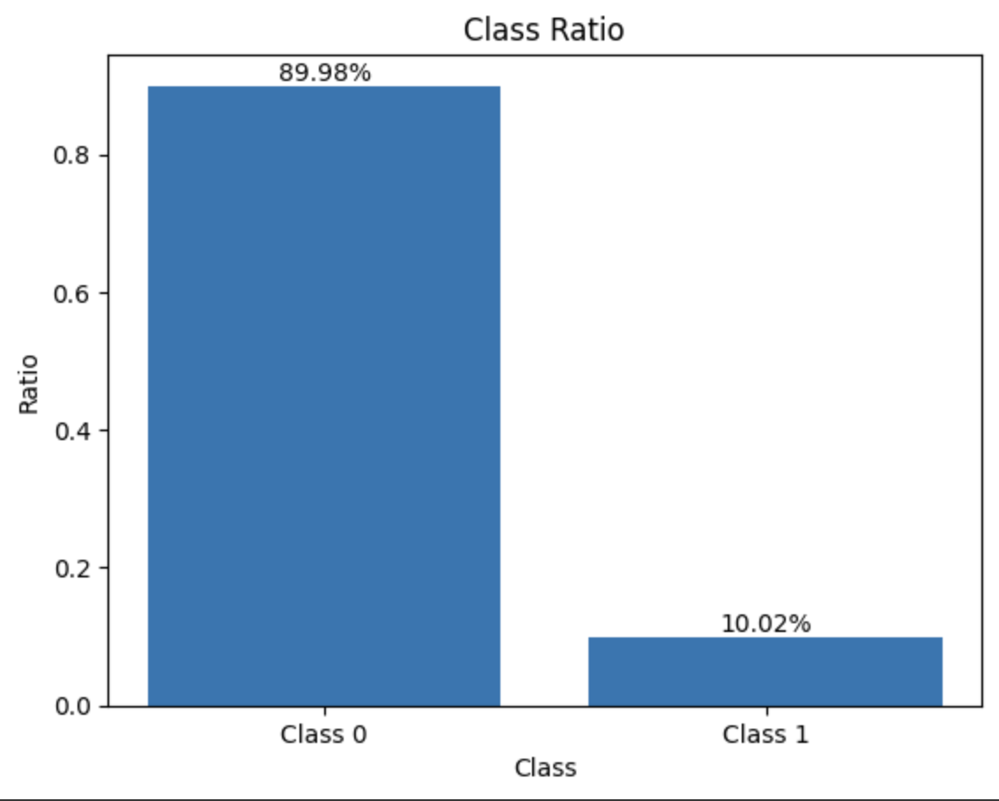
Hmmm- Skew Ratio Plot and Balance
Notes:
Skew Ratio Plot-
analyzes the 'target' column's class distribution by calculating the frequency and proportion of samples for each unique class to evaluate class balance.
In order to fix this I create copies of my data randomly selecting records from class 0 to match the count of class 1 and federated them into one new data frame for reprocessing leveraging the same methods are before.

Slide 9
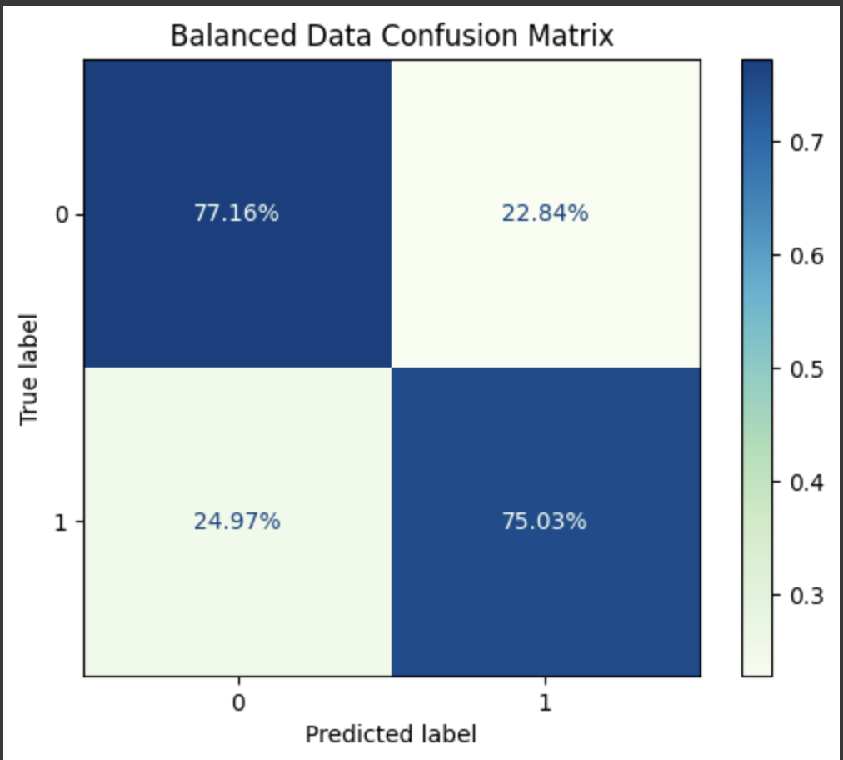
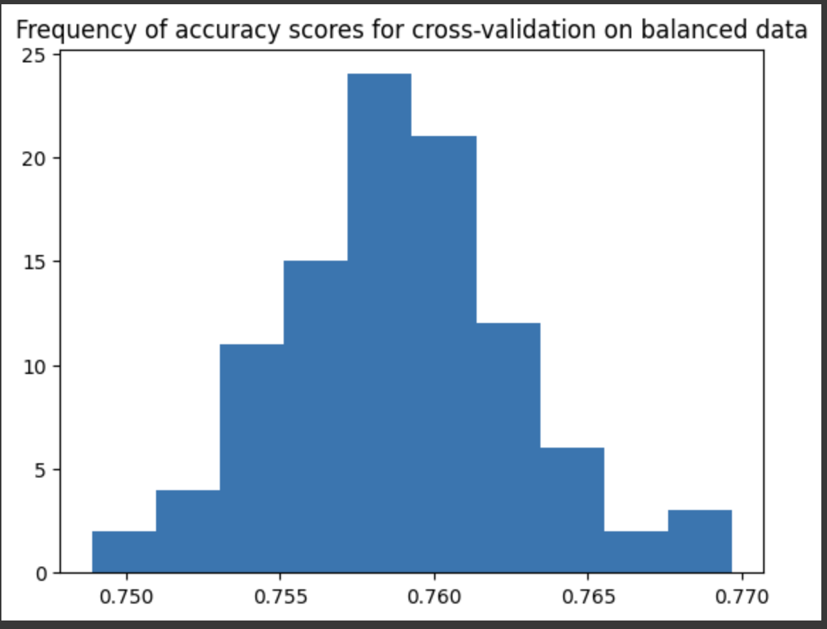
Results 2
75%
Accuracy Score
Notes:
Balance data set give you a well balanced trained model. Other wise you will have a large number of false positives as we saw with our unbalanced data set.

Slide 10
Lessons Learned & Modifications
01
03
02
Pair Plot with large data set
Random
Over/Under Sample
Feature Selection
Notes:
Large data sets do not render performantly or in a way you can visually understand do to the mass of data and plots.
Working with 50 features can become combursome and have a marginal diminished return on narrowing your feature set.
imbalanced-learn

Slide 11
Conclusion
Is your Data skewed?
False Positives
Accuracy score <> comprehensive.
Size matters (computation expense).

Slide 12
Thanks
Sources:
Data Source:
http://ddc-datascience.s3-website-us-west-1.amazonaws.com/Projects/Project.1-Transactions/Data/Transaction.train.csv
Git Repo:
https://github.com/bdugick89/Data-Science-Bootcamp/blob/main/Project%201/Brannon_Dugick_Project_1_Naive_Bayes_Classification.ipynb
Images:
https://www.kaggle.com/discussions/general/468420

